Slide 1
ALASKA2 Image Steganalysis
by Lara , Sharon ,& Shai

Slide 2


1. Intro
Dataset Explanation
Image processing and transformation JPEG RGB and DCT
Model EfficientNet , Optimizer,
Result and ways to improve AUC, TensorBoard

Slide 3
Steganography
Steganography is the art of covert communication, in which the sender hides a message in innocuous-looking objects so that the existence of the message itself is not discovered.
In this context, an unaltered object used to hide a message is called a cover object, and an altered object in which a message is embedded using steganography methods is called a stego object.
The majority of modern steganography uses digital images as cover objects and embeds messages by modifying them so slightly that the human eye can barely see the difference.

Slide 4
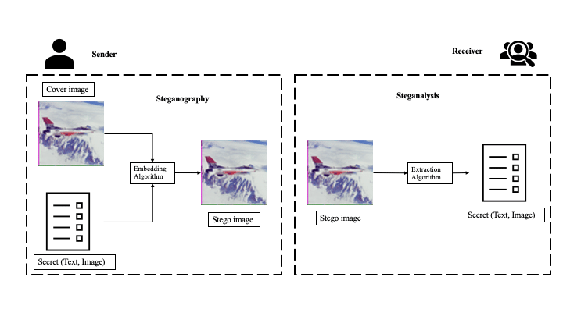
Notes:
Steganalysis is the activity to detect stego objects. The trend in image steganalysis is
to use machine learning. In recent years, deep learning, which has made great achievements in the computer vision and other various fields, has also been used to improve the accuracy of detection.
However, datasets and metrics used in the vast of those researches were not based on realistic processes. Therefore, such methods were not immediately useful to practitioners.

Slide 5
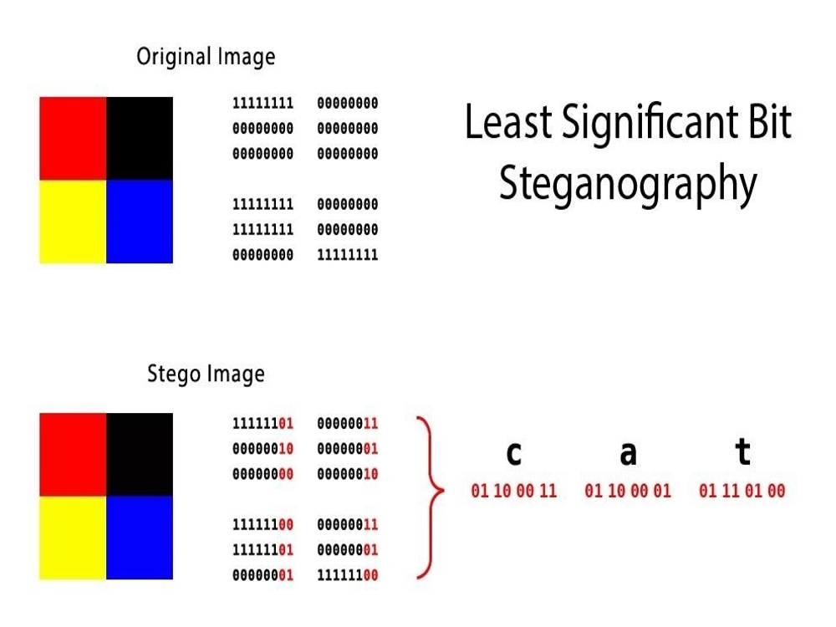
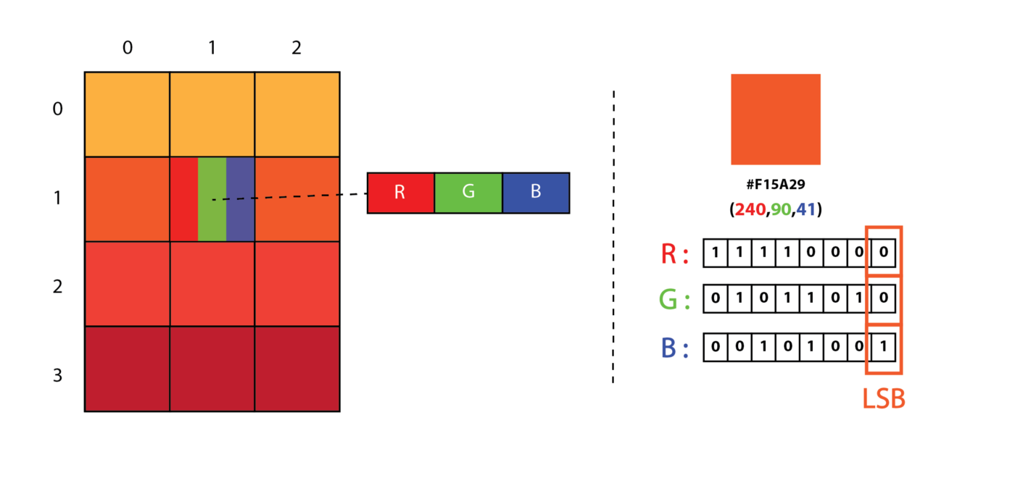
Simple Steganography - LSB
Notes:
The most common way steganography is accomplished is via LSB.

Slide 6
ALASKA2 Image Dataset
Goal:
Determine which of the images in the test set have hidden messages embedded (Multiclass classification)
Dataset:
JPEG compressed images datasets:
Unaltered images ("Cover" image) - 75k examples
Corresponding examples in which information has been hidden using one of three steganography algorithms (JMiPOD, JUNIWARD, UERD).
75k examples of each embedding algorithm.
Data can be hidden within images using 3 main algorithms -
JMiPOD
JUNIWARD - Universal Wavelet Relative Distortion
UERD - Uniform Embedding Revisited Distortion
The images are all compressed with one of the three following JPEG quality factors: 95, 90 or 75.
Notes:
The goal of the ALASKA challenge was to stimulate the development of new hidden data detection methods dedicated to perform practical, “real-life”, steganalysis; i.e. to detect stego contents in environments which are closer to an operational forensic analyst context.
Previously - a very academic-approach.

Slide 7
PyTorch Dataset
Sample Data: 37524
9381 from each group
GroupKFold cross-validator, ensures that the same group is not represented in both validation and training sets.
Multiclass classification - generated 4 different classes for the target label
0 - cover (no stego), 1,2,3 - according to stego algo
Implemented with onehot custom transformer
Used Augmentation to define a transform to convert an image to a PyTorch Tensor.
Notes:
class DatasetRetriever(Dataset)
We generated 4 different classes for the target label.
convert an image to a PyTorch Tensor from ndarray (OpenCV)

Slide 8
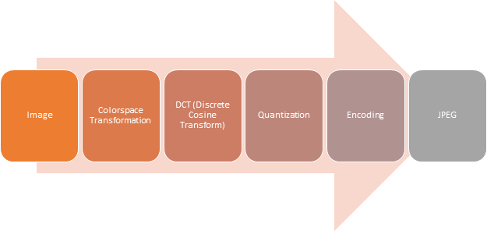
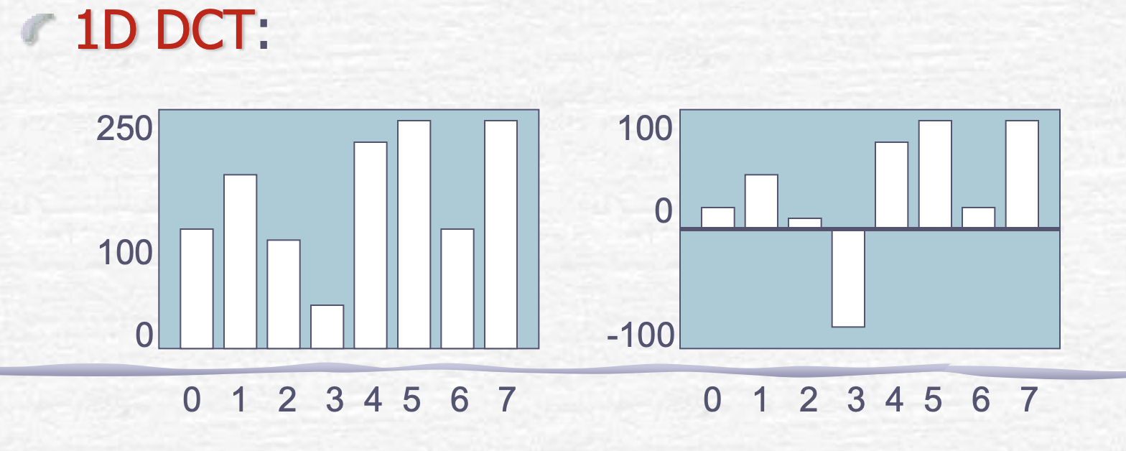
Image processing
Introduction to JPEG
The Discrete Cosine Transform (DCT)
JPEG is not a file format , it's a compressing algorithm for an image file to reduce its size, without losing a lot of information. Steps involved in compressing an image using JPEG image :
DCT is applied on the pixels of the color channels, using DCT coefficient.
Convert from spatial domain to frequency domain
Be able to separate what the eye can see from imperceptible
Notes:
Firstly the image is converted into YCbCr from RGB channels. YCbCr and RGB are both color spaces having different channels where YCbCr consists of three channels as Luminance(Y), Cb and Cr are the chromaticity - Cb (Cb is blue minus luma (B-Y)), Cr (Cr is red minus luma (R-Y)).
Down sample - reduce the amount of color in our image, saves space without seeing difference in image quality.
When JPEG tries to compress an image, a lot less bits to the high frequency components whereas for lower frequencies more bits are used as the changes are more apparent.
When JPEG compresses the image it chops down the image to little chunks of 8 by 8 pixels and each one of these little blocks are actually represented by their own DCT grid.
Huffman coding tries to tackle, it looks through frequency of letters in text, letters that appear most often are altered to the least number of bits. Chars more rare - more bits. It takes a look at the incoming information first and generates of the fly an encoding scheme that works best for the incoming input. The compression is tailored to the input.
JPEG - Huffman coding looks at the information it has to encode and decides which elements occur very often - a lot less bits for them, whereas pieces of inputs data that occur rarely - more bits.
Try to represent the image data as the sum of lots of the cosine waves

Slide 9
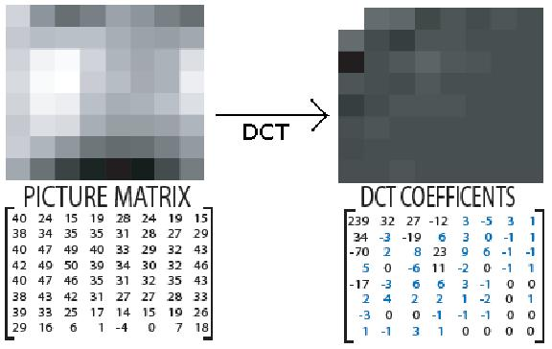
Using DCT Coefficients
Motive:
We wanted to lower the resolution of the image without hurting important elements in it.
Convert RGB to DCT coefficients and use them for the model.
The human eye has difficulty identifying details that are very close together.
Such details can be discarded without apparent loss of quality - DCT helps identify what to throw away.
In order to find such details - represent an image in terms of its frequencies.
Highest frequencies - can be discarded.
Can use much lower accuracy to store high frequency components.
Notes:
DCT helps us separate these frequencies from the rest of the image.
In Quantization we throw away data - attempts to minimize information loss by preserving the most important coefficients, whereas less important coefficients are roughly approximated.
Split each image to 8x8 pixel groups.
Each group separately encoded with its DCT
We want to lower the resolution of the image without hurting important elements in it.
Coefficients represent the contribution of each pixel blocks to the whole.

Slide 10
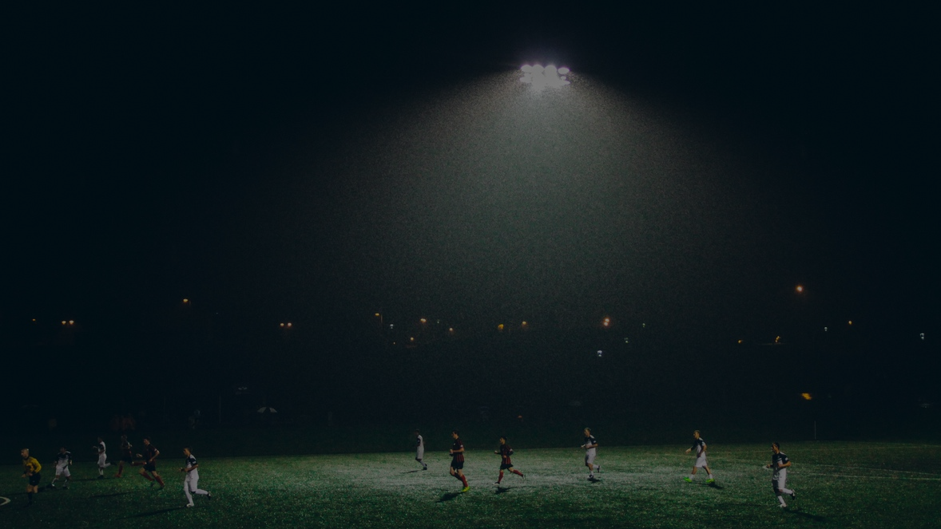
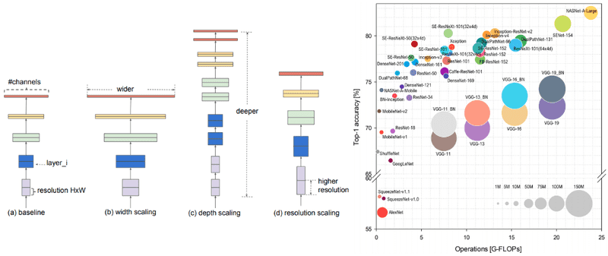
EfficientNet- width, depth, resolution

Slide 11
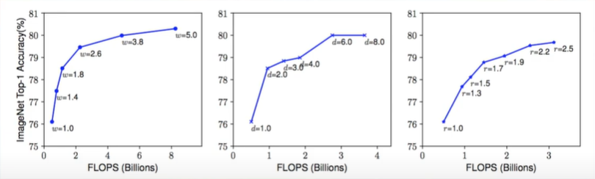
Scaling up along single dimensions
“If the input image is bigger, then the network needs more layers to increase the receptive fields and more channels to capture more fine-grained patterns on the bigger image”

Slide 12
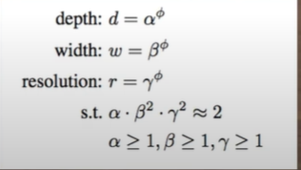
Compound Scaling Method
Fix phi = 1, assuming twice more resources, and do a small grid search of alpha, beta, gamma
EfficiantNet-B0: alpha = 1.2, Beta = 1.1, gamma =1.15
Under the constraint a * beta² * gamma² = 2
2. We then fix alpha, Beta, gamma as constants and scale up
Baseline network with different phi to obtain EfficnatNet B0-B7
Better performance might be achieved by searching for alpha, Betta,
gamma around a large model, but the search cost becomes much
larger, therefore this issue is solved by starting from scratch with
small network.

Slide 13
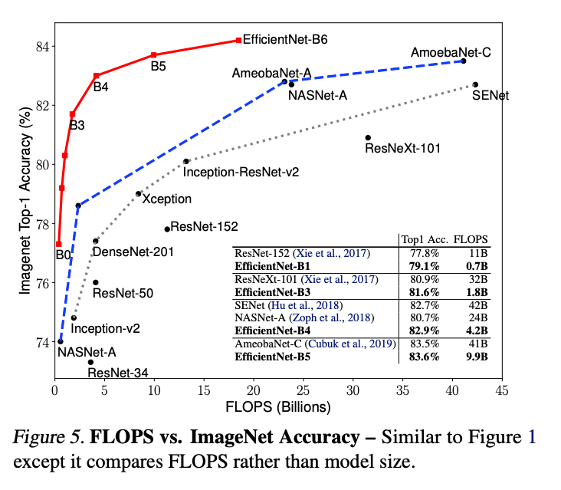
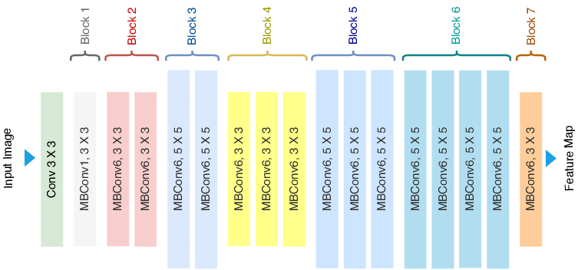
EfficiantNet

Slide 14
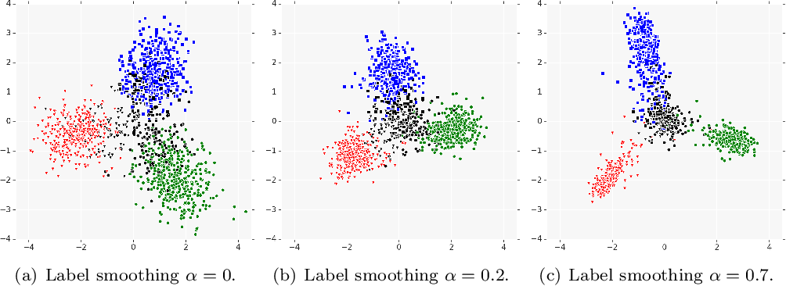
Label Smoothing Regularization

Slide 15
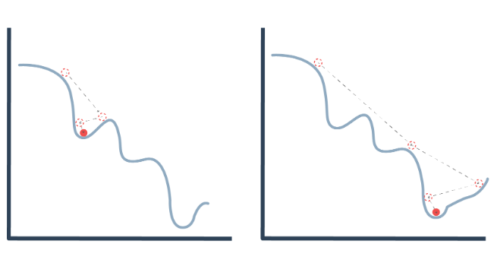
Optimizer and final run parameters
Optimizer
Final run parameters
Optimizer : using AdamW is a variant of the optimizer Adam that has an improved implementation of weight decay. Using weight decay is a form of regularization to lower the chance of overfitting Main Adjust parameters : - Learning rate - learning rate is controlling the size of the update steps along the gradient - Weight decay - Weight decay is a form of regularization to lower the chance of overfitting
Batch size | 12
Number of Epochs | 3
Learning rate | 0.0009
Weight decay | 0.001-0.005

Slide 16
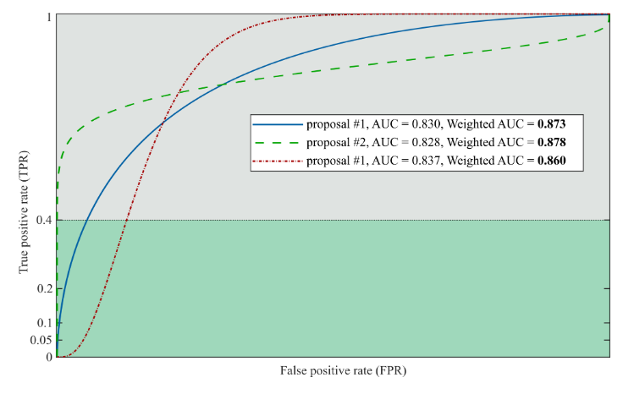
Weighted AUC
The figure below illustrates the different areas. This example also shows that the submission #2 has the lowest AUC but is ranked first since it outperforms its competitors for low False Positive Rate (FPR). On the opposite, the submission #3 has the highest AUC but would have been ranked third.
Focus on reliable detection with an emphasis on low false-alarm rate, submissions are evaluated on the weighted AUC. To calculate the weighted AUC, each region of the ROC curve is weighted.
In our case the area between the true positive rate of 0 and 0.4 is weighted 2X, the area between 0.4 and 1 is now weighed (1X). The total area is normalized by the sum of weights such that the final weighted AUC is between 0 and 1.

Slide 17
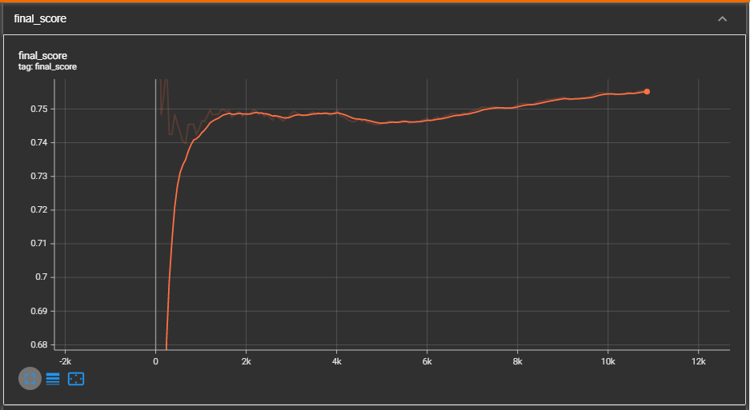
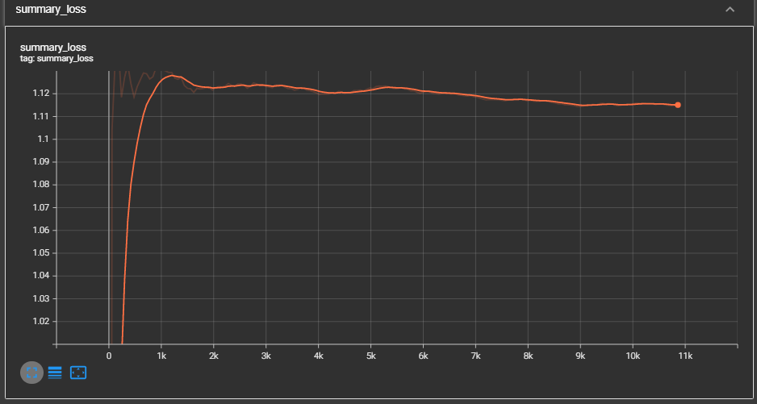
TensorBoard and final score and summary loss
Final score:

Slide 18

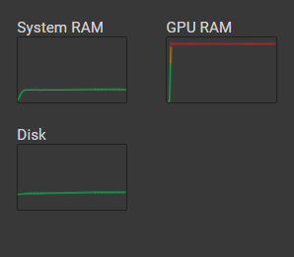
How to improve the score
Using larger DataSet: From the test we did started with ~20K images DataSet with a score of ~0.68 and when we double the DataSet to ~40K we improve to 0.78, the whole Dataset is ~400K images any use in PySpark or cloud would have improve the result.
Better GPU and GPU memory - because of the GPU we got we could not run more than 12 batch size (the CUDA collapse out of GPU memory) this would improve the runtime and make it so we can do more runs
Train our own model - we used pre train EfficiantNet , what we wanted is to train the model by ourselves (maybe change to EfficiantNetV2) but this take time and computing power which we didn’t have (something like a 2 weeks to a month).

